Slide 1

Ecommerce Sentiment Analysis
Guided By:
Mr. Anay Tamhankar
Mr. Prasad Deshmukh
Submitted By:
Ajay Yadav (230343025003)
Nomesh Verma (230343025035)
Swarup Shinde (230343025044)
Sanket Zargad(230343025057)
24/08/2023
1

Slide 2
Introduction
The "Ecommerce Sentiment Analysis" project focuses on analyzing customer sentiment towards products available on Amazon. By using natural language processing (NLP) techniques, the project aims to extract and analyze customer reviews to understand the overall sentiment associated with different products and categories.

Slide 3
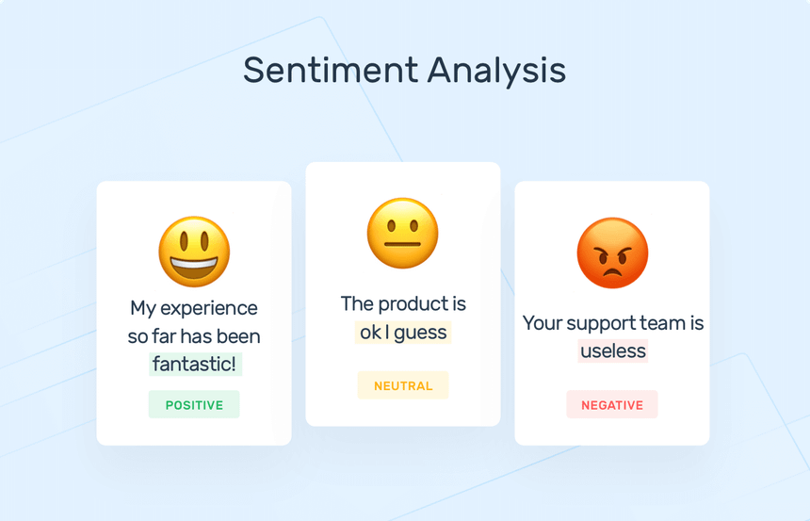

Slide 4
Problem Statement
In the rapidly evolving e-commerce landscape, businesses struggle to effectively understand customer sentiments from a plethora of Amazon product reviews. This leads to missed opportunities for improving customer satisfaction and making data-driven decisions.
The lack of a tailored sentiment analysis system for Amazon reviews hinders businesses from gaining insights into customer preferences, trends, and satisfaction levels, which are essential for maintaining a competitive edge.

Slide 5
Data Input
System Architecture
Pre-Processing using PySpark
(Clean missing values,
Selecting important features.)
Deep Learning(NLP)
Sentiment Analysis
using NLTK
Run Model
Visualization..

Slide 6
Sentiment Analysis model:-
1) Text Review
2) Data Preprocessing
3) Sentiment Analysis
4) Sentiment Classification
5) Result
6

Slide 7
Machine Learning Algorithms
NLP(Natural Language Processing) –
Text Processing :-
Tokenization (splitting text into words or sentences)
Stemming (reducing words to their base form)
Lemmatization (reducing words to their dictionary form)
2. Sentiment Analysis :-
Emotional tone expressed in text
Review is positive or negative.
3. Text Summarization :-
Summaries of long texts, making it easier for users to grasp the main points

Slide 8
2) Sentiment Analyzer –
NLTK (Natural Language Toolkit) is a widely-used Python library for natural language processing tasks.
It provides various tools and resources that can be leveraged to create a simple sentiment analyzer.
Tools and Technologies–
PySpark is the Python API for Apache Spark. It enables you to perform real-time, large-scale data processing in a distributed environment using Python. It also provides a PySpark shell for interactively analyzing your data.
Tableau

Slide 9
Data Visualization & Representation

Slide 10


Most Common Texted Words

Slide 11
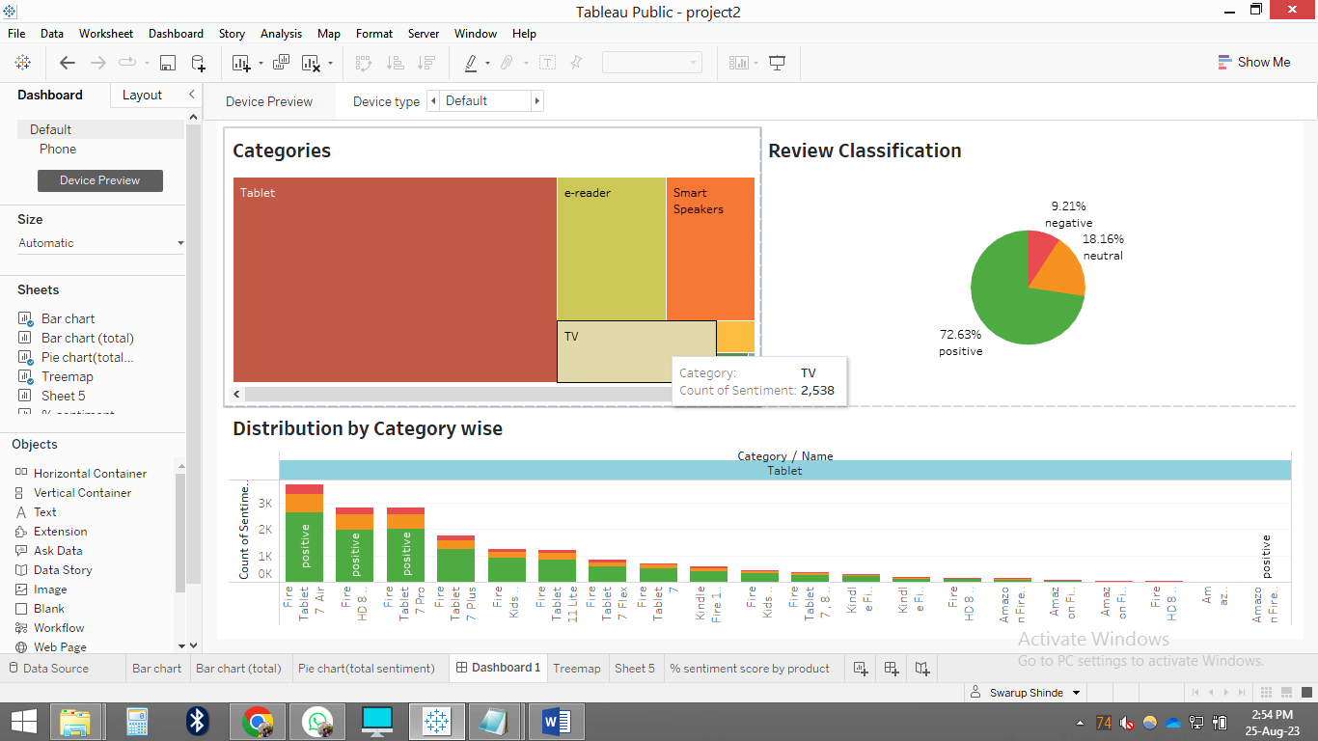
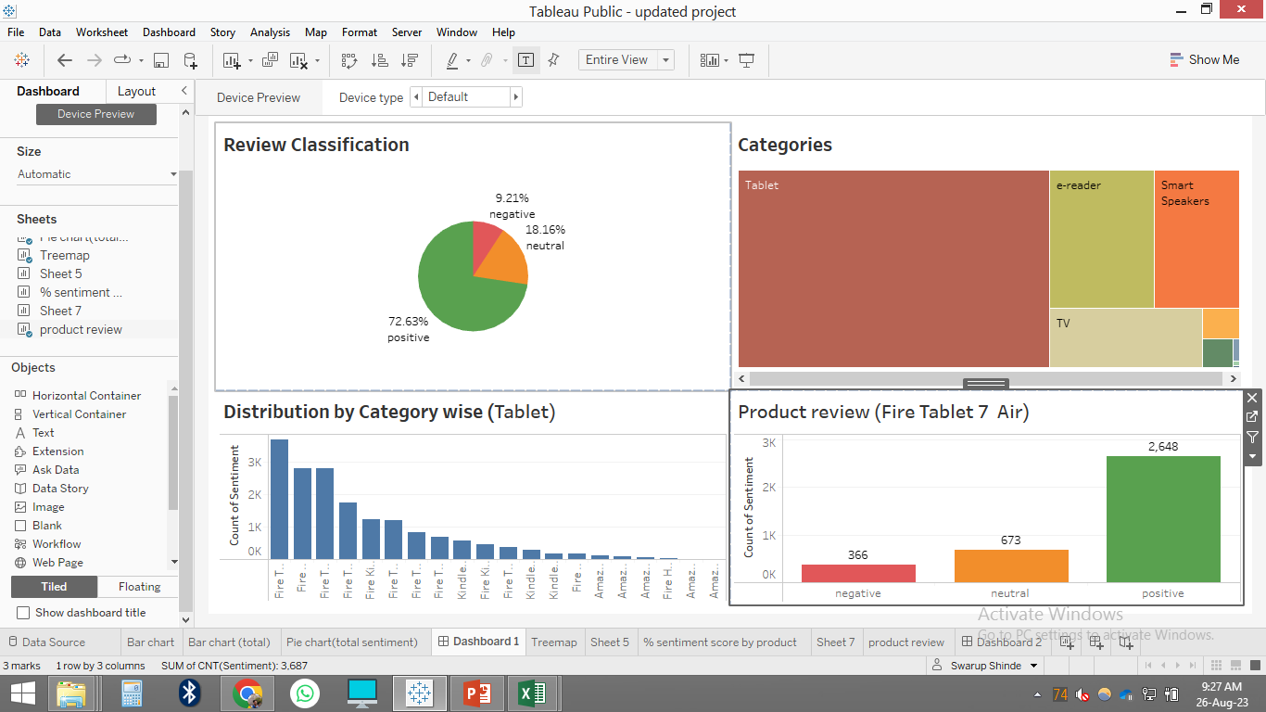

Slide 12
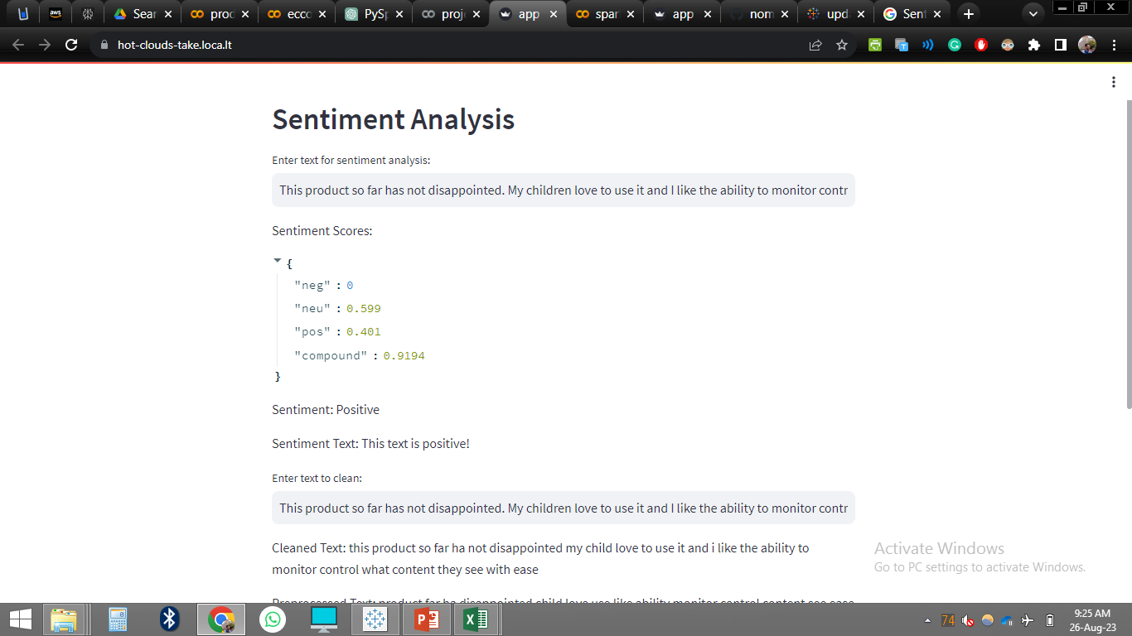

Slide 13
Data Analysis
Name: |  | Kindle Fire 16gb Plasma Tablet
Sentiment: |  | negative
Count of Sentiment: |  | 21
% of Total Count of Sentiment along Table (Down): |  | 0.075%
Name: |  | Amazon Fire Tv 4k
Sentiment: |  | positive
Count of Sentiment: |  | 151
% of Total Count of Sentiment along Table (Down): |  | 0.541%

Slide 14
CONCLUSION AND FUTURE SCOPE
After analyzing dataset, we can conclude that Machine Learning can be effectively used for understanding the customer’s sentiment.
According to the Deep Learning (NLP) model, approximately 74.6% of customers were satisfied with the product, while 7.7% of customers were not satisfied. Additionally, about 17.7% of customers expressed a neutral sentiment towards the product.
In conclusion, leveraging machine learning algorithms enables businesses to make informed decisions by analyzing customer sentiment. This approach aids in prioritizing essential organizational actions and areas of focus.

Slide 15
Thank You
15

